Slide 1
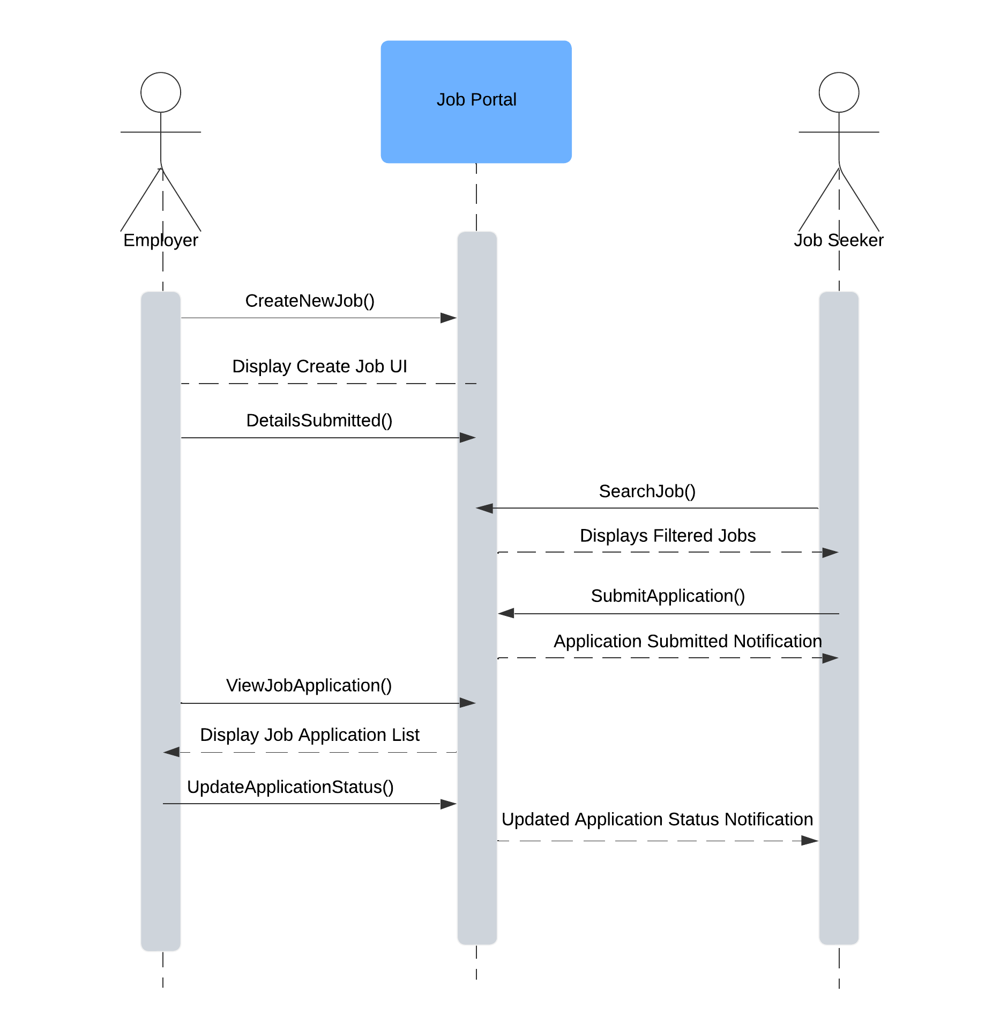
HIREHUB SEQUENCE DIAGRAM
Use Case – 03.01 Create Job Listings & 02.02 Apply for Jobs
Use Case Scenario
The Employer creates a new job through the job portal.
The job portal makes the job listing visible to job seekers.
The job seeker interacts with the job portal to search for jobs or submit an application.
The employer reviews the application, takes action to shortlist the candidates.
The portal notifies the job seeker on application updates.

Slide 2
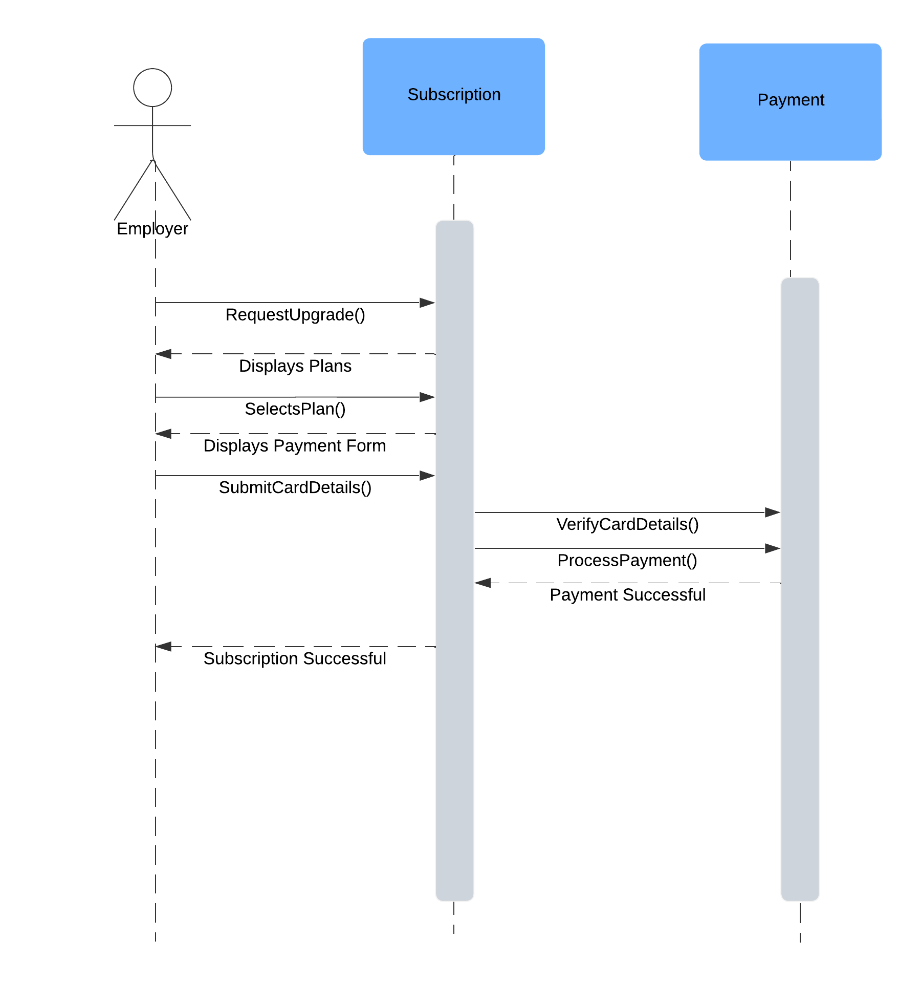
HIREHUB SEQUENCE DIAGRAM
Use Case – 04.01 Manage Subscription Plans & 04.02 Process the Payments
Use Case Scenario
The user initiates a subscription process by interacting with the Subscription system.
The Subscription system sends a request to the Payment system to process the payment for the subscription.
The Payment system processes the payment and returns the transaction result to the Subscription system.
The Subscription system updates the user’s subscription status based on the payment response.

Slide 3
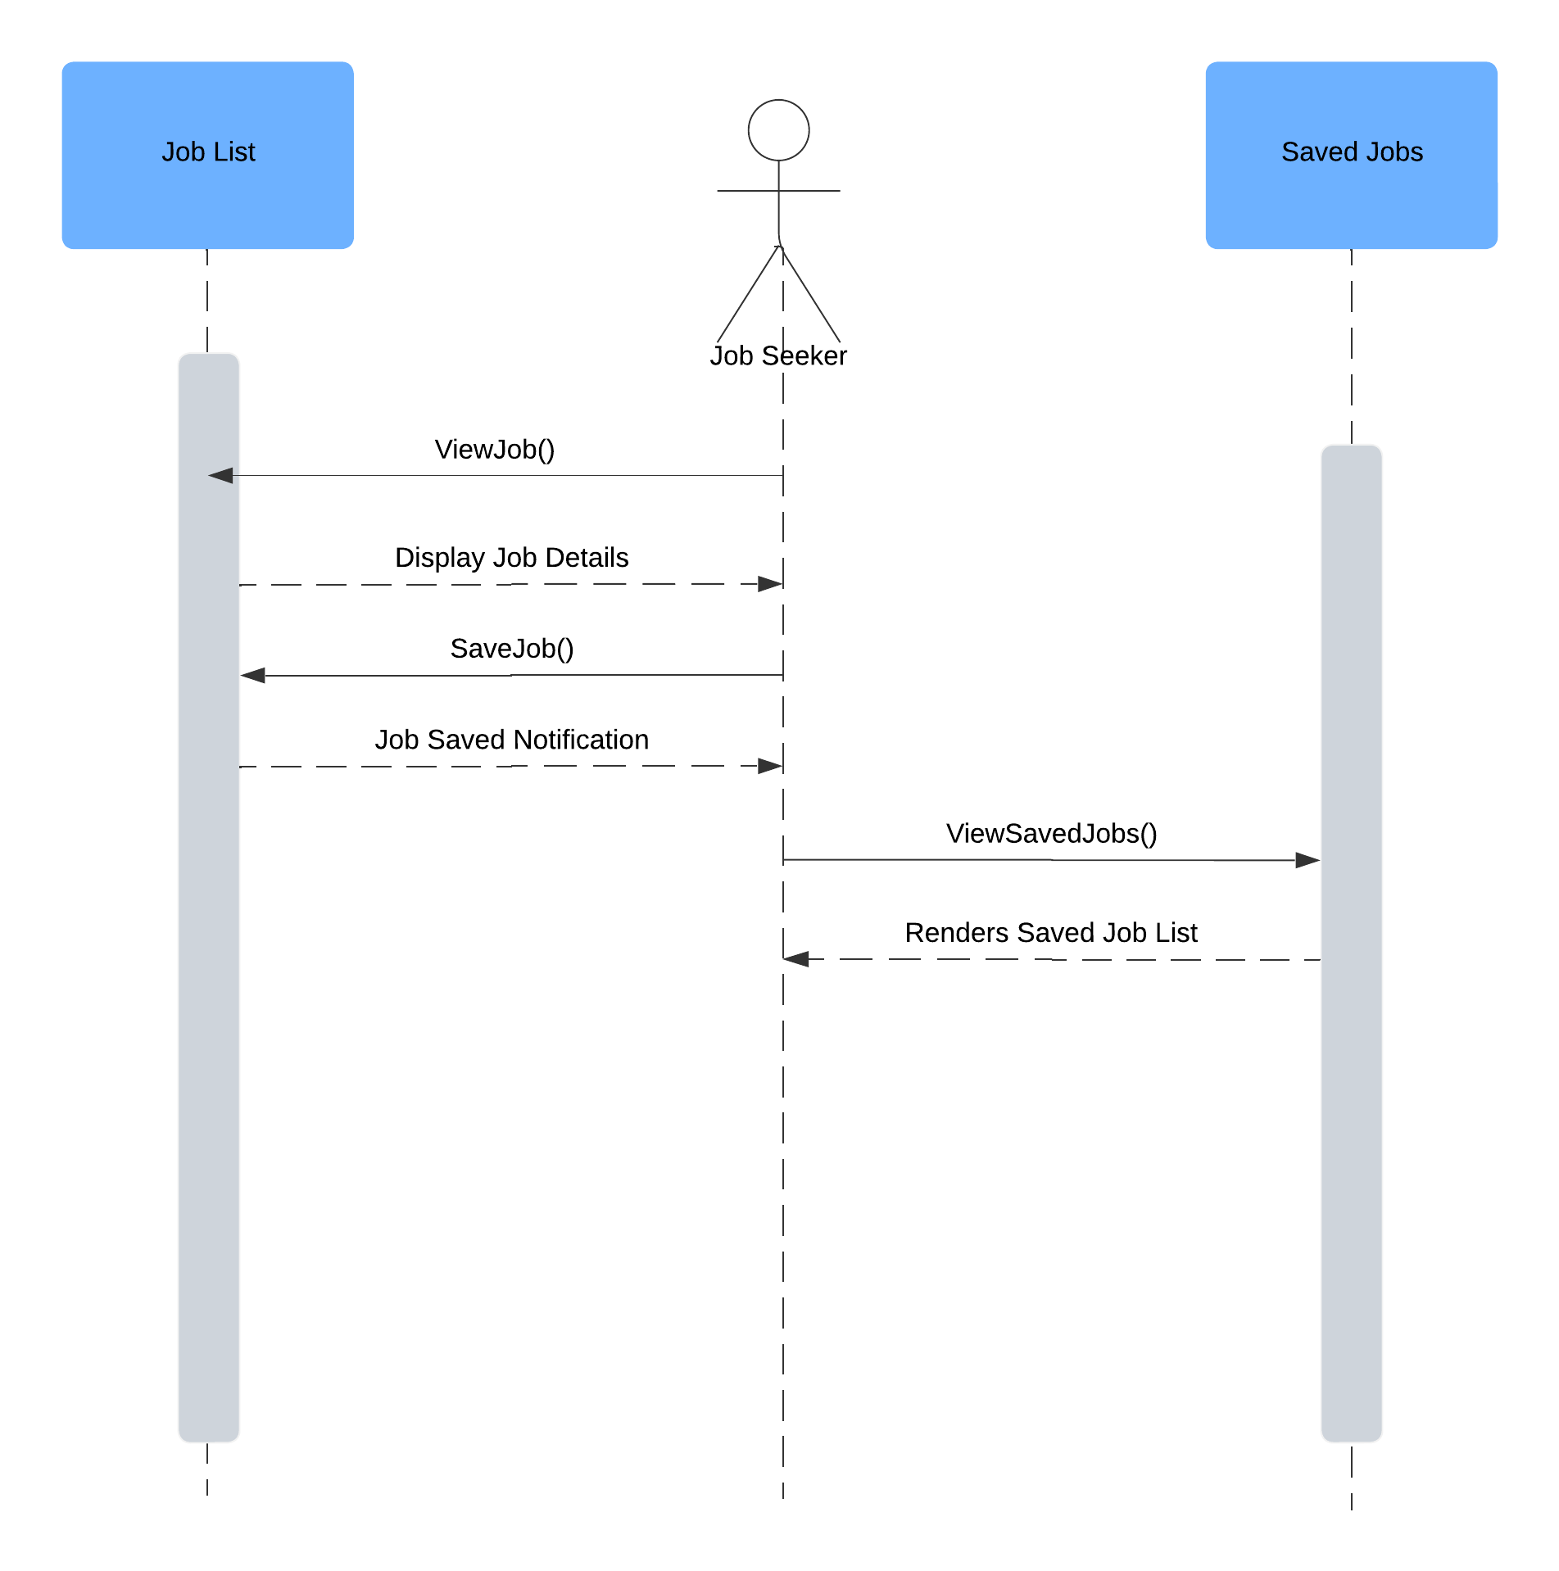
HIREHUB SEQUENCE DIAGRAM
Use Case – 02.04 Save Job Searches
Use Case Scenario
The user interacts with the Job List system to retrieve a list of available jobs.
The Job List system processes the request and returns a list of jobs to the user.
The user selects a job from the list and saves it to their Saved Jobs list.
The Saved Jobs system updates its database with the selected job and confirms the save action.
The user can then view the updated list of saved jobs through the Saved Jobs system.

